Slide 1
Curriculum Committee 2018-19 Annual Report
Notes:
Updated 8-18-15, 2015

Slide 2
Curriculum Committee Membership 2018/19
Frank Corona------------- Chair
Jeff McAlpine------------- Alternate Chair
Mary Jean Williams------ Alternate Chair
David Plotkin----------Vice President, Instruction & Student Services
Jason Kovac------------Dean, Institutional Effectiveness & Planning
Dru Urbassik-----------Director, Curriculum & Scheduling
Megan Feagles------- Curriculum & Scheduling Office/Recorder
Elizabeth Carney --------- Assessment Coordinator
Academic Foundations and Connections (AFAC)
Tara Sprehe
Darlene Geiger
Karen Ash
Sarah Steidl
Dustin Bare
Lupe Martinez
Kara Leonard
Suzanne Munro
Jeff McAlpine
Tracy Nelson
Scot Pruyn

Slide 3
Curriculum Committee Membership (cont.)
Arts & Sciences
Sue Goff
Lisa Reynolds
Rick Carino
Nora Brodnicki
Frank Corona
Lilly Mayer
Jackie Flowers
Rich Albers
Technology, Applied Science, and Public Services (TAPS)
Cynthia Risan
Shalee Hodgson
Sharron Furno
Dave Bradley
Ida Flippo
Mike Mattson
Helen Wand
Jeff Ennenga
Student Representatives
Yessica Ramos
Jinyoung Park

Slide 4
Curriculum Committee Mission
In supporting the mission of the College, the Curriculum Committee oversees the quality and content of course outlines and transfer and non-transfer degree and certificate requirements in accordance with the policies and guidelines of the Northwest Commission of Colleges and Universities (NWCCU) and other relevant agencies. The committee provides guidance, advocacy, and oversight for curricular issues that are cross-departmental or institutional in scope and impact. The Curriculum Committee works with the Curriculum Office, Instructional Standards & Procedures (ISP) Committee, the Assessment Committee and other college entities as necessary.
The committee provides guidance, advocacy, and oversight for curricular issues that are cross-departmental or institutional in scope and impact.
The Curriculum Committee works with:
The Curriculum Office;
Instructional Standards & Procedures (ISP) Committee;
The Assessment Committee and other college entities as necessary.

Slide 5
Curriculum Committee Primary Functions
The committee reviews and makes recommendations regarding new courses, revisions to existing courses, transferability, general education and related instruction issues, and new and revised programs.
1. Provide oversight of all new or changed course outlines and program proposals to ensure that academic standards are maintained.
2. Evaluate the impact of curriculum proposals on the College to assure that the curriculum offered is complementary and integrated.
3. Approve or disapprove new or changed course outlines and programs and recommend quality and conformance to best curricular practice throughout the College.
4. Establish, review and revise procedures and guidelines as needed to assure quality and conformance to best curricular practice throughout the College.

Slide 6
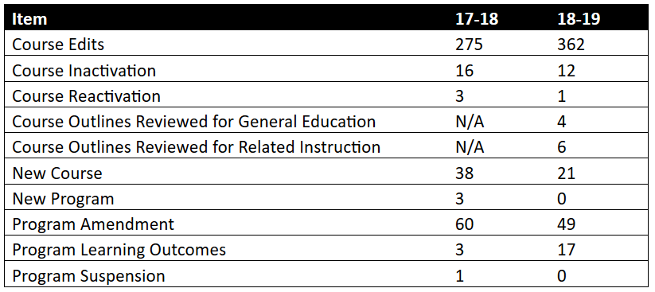
Approvals*
Totals 399 472
*Note: Approvals as of early March for both Academic years.

Slide 7
Five Year Course Review Cycle
Year 1
2016/17
Year 5
2020/21
Year 2
2017/18
Year 4
2019/20
Year 3
2018/19
We are currently in Year 3 of the current 5 year review cycle

Slide 8
Objectives for the Academic Year
Eliminate backlog of edited outlines from when CCC had a three year review cycle
15 outlines left from previous annual update, backlog now cleared entirely.
Provide focus on General Education and Related Instruction reviews
Creation and implementation of face to face and/or virtual review teams for both of these certification areas;
Creation and implementation of checklists for review that reflect state requirements.

Slide 9
Both General Education and Related Instruction sub-committees are actively using specific checklists to review courses.
4 General Education and 6 Related Instruction courses reviewed and approved during the current academic year:
ART-291 (Arts/Letters)
WR-121 (Writing)
WR-122 (Writing)
WR-227 (Writing)
WR-122 (Comm)
WR-121 (Comm)
COMM-140 (HR)
COMM-218 (HR)
HPE-296 (PE/H/S/First-Aid)
WR-227 (Comm)

Slide 10
Objectives for the Academic Year (cont.)
Review teams knowledge sharing
Course outline review teams shared review methods and techniques with other teams.
Student engagement and committee participation
Engagement initiated with John Ginsberg and ASG to discuss student participation in committee work. Issues that were identified included:
Lack of student participation continuity;
Lack of student preparedness for committee work;
Lack of identified relevance to the general student body;
Roles and responsibilities of student committee participants not clearly spelled out.

Slide 11
Objectives for the Academic Year (cont.)
Student Engagement and Committee Participation
Opportunities that were identified included:
Active solicitation of student involvement by Committee chairs;
Debrief with John and student participants on roles and responsivities after review period;
Generate a one- pager committee “student charter” summarizing the committee work and role of the student for onboarding facilitation.
Learnings from this work can be universally adopted by other committees with student involvement.

Slide 12
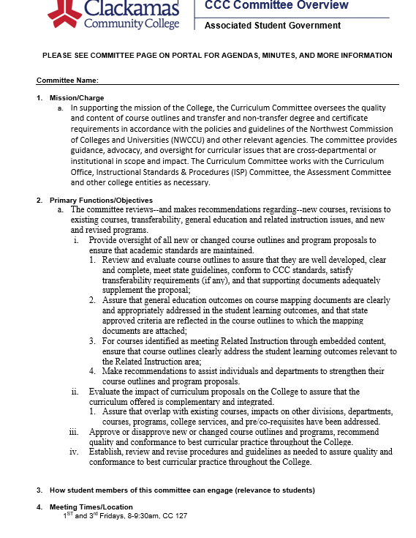
3. How student members of this committee can engage (relevance to students)

Slide 13
Objectives for the Academic Year (cont.)
Student Engagement and Committee Participation
Opportunities that were identified included:
Active solicitation of student involvement by Committee chairs;
Debrief with John and student participants on roles and responsivities after review period;
Generate a one- pager committee “student charter” summarizing the committee work and role of the student for onboarding facilitation.
Learnings from this work can be universally adopted by other committees with student involvement.

Slide 14
Objectives for the Academic Year (cont.)
Amendment and Catalog Orientation and Workshops
Curriculum committee actively involved with refresher and new member on boarding orientation programs.
Course Flowcharts Updated and Revised;
Shared Governance with other Committees.

Slide 15
2019/20 Look Ahead
Foundational Curricula
The Foundational Curriculum is intended as a starting point for students who plan to transfer to a university, but are unsure as to their intended major or transfer destination
Two pathways: General Pathway and STEM Pathway
Expected that all classes to transfer to meet at least 30 credits of general education requirements
Curriculum Management Software
Curriculum management;
On-line catalog;
Scheduling.

Slide 16
Thank you!

